Slide 2
Decision Making
Decision making is the process of selecting the best course of action among several alternatives.
It involves identifying the problem or opportunity, gathering relevant information, evaluating potential options, and choosing the most appropriate solution.
Decision making can be rational, intuitive, or a combination of both.
Effective decision making requires critical thinking skills, creativity, problem-solving abilities, and sometimes the ability to manage uncertainty and risk.
It's essential to balance analytical thinking with intuition and to consider both short-term and long-term consequences when making decisions.
Additionally, learning from past decisions and feedback is crucial for improving decision-making skills over time.

Slide 3
Decision Making Process
Identification of problem
Implementation of alternative
Evaluation of decision effectiveness
Identification of decision criteria
Allocation of weights to criteria
Development of alternatives
Analysis of alternatives
Selection of alternative

Slide 4
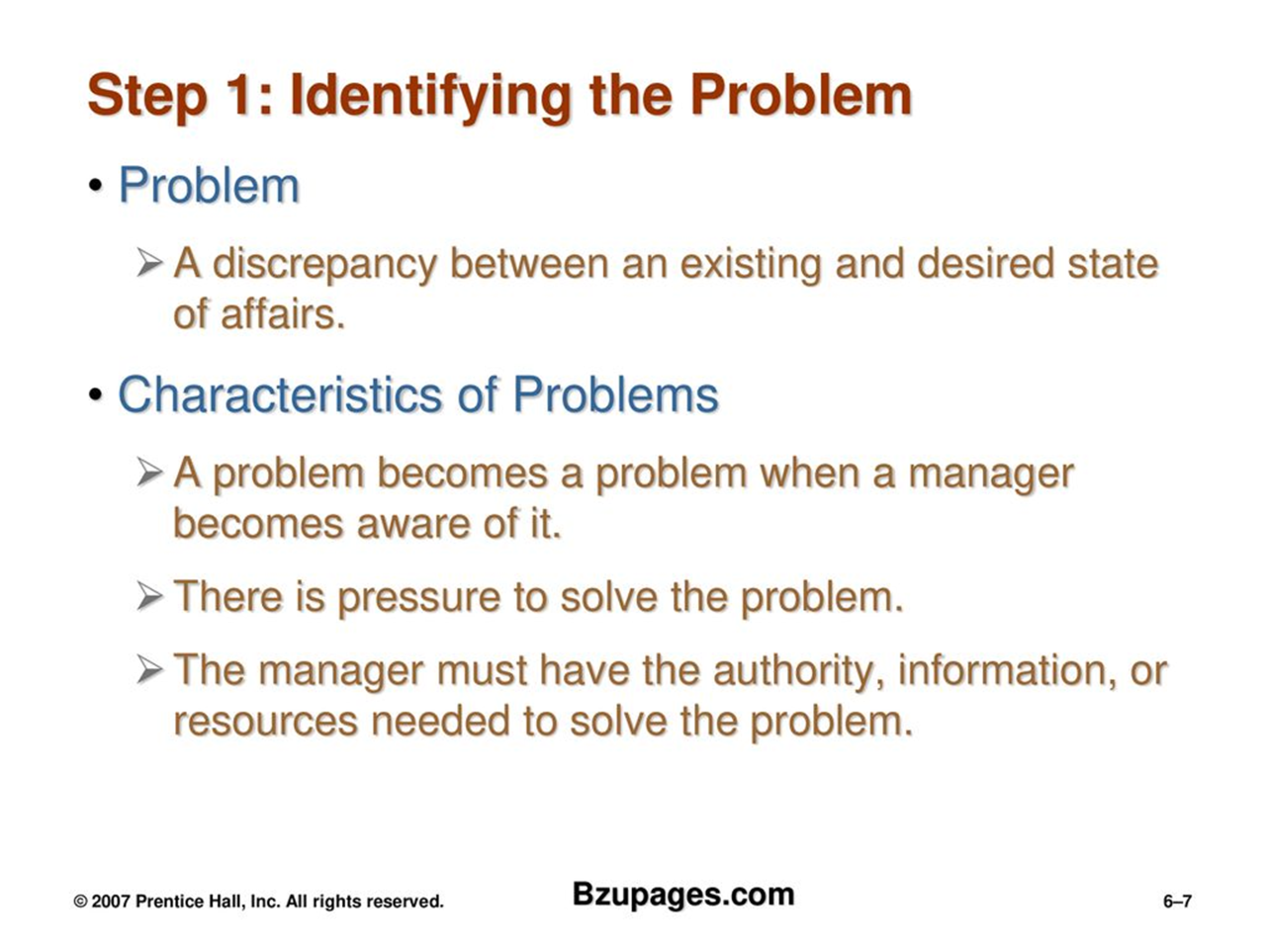

Slide 5
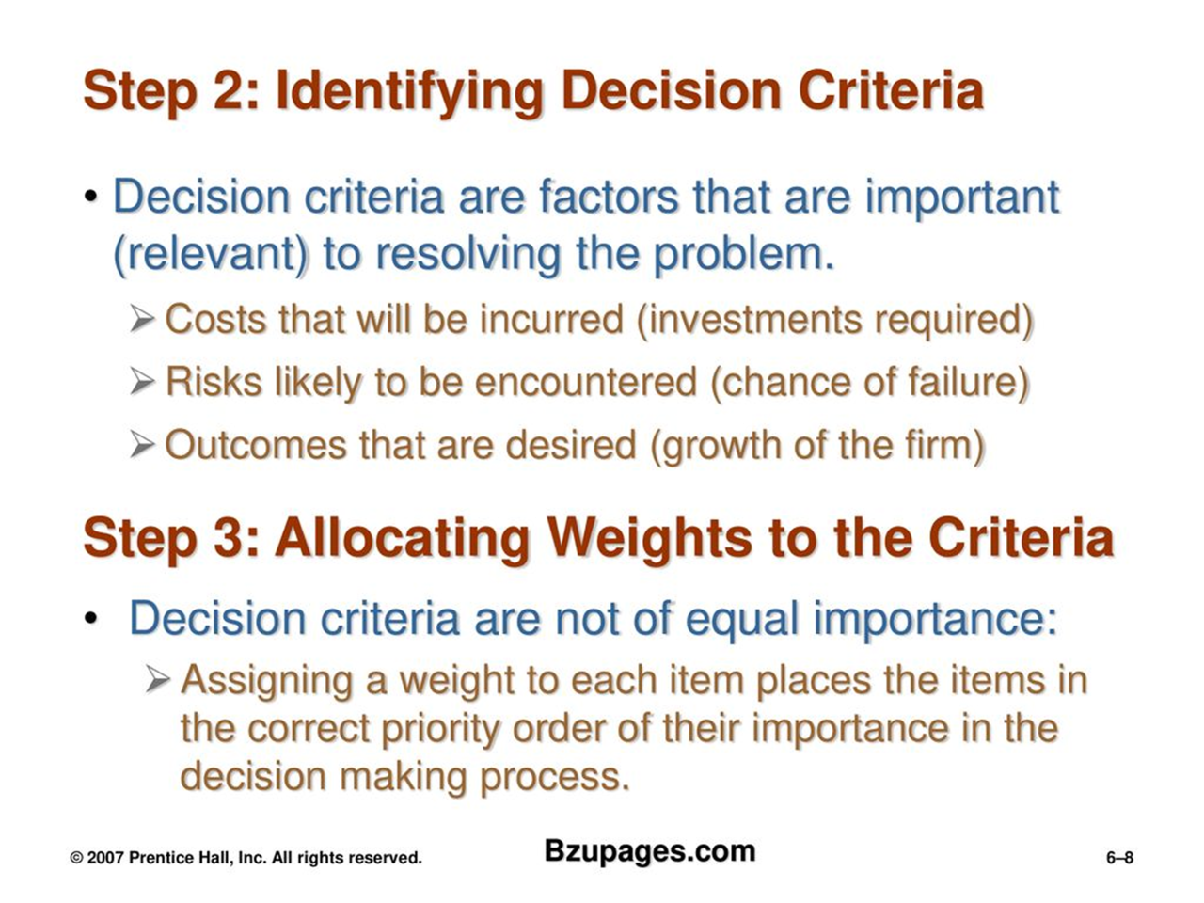

Slide 6
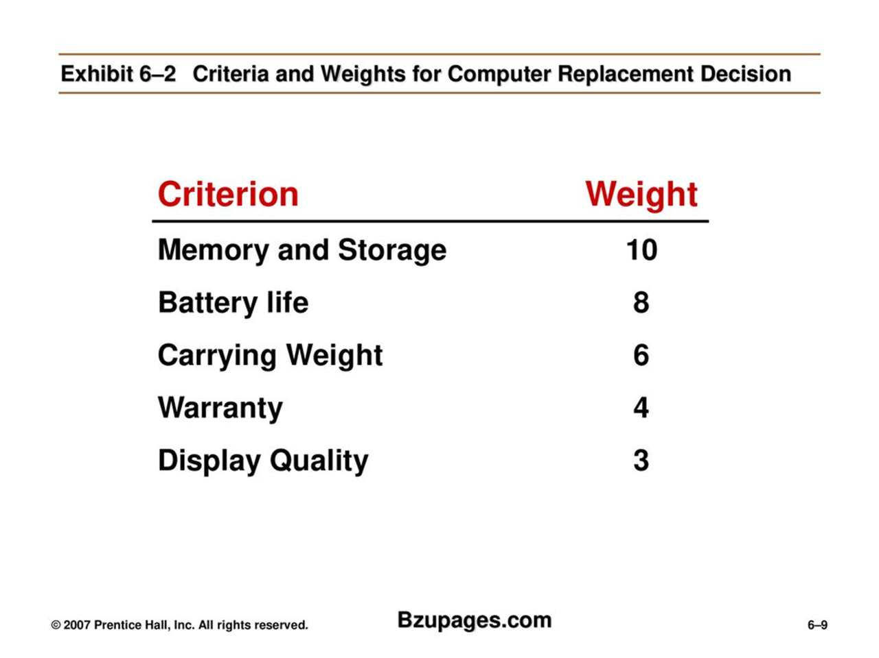

Slide 7
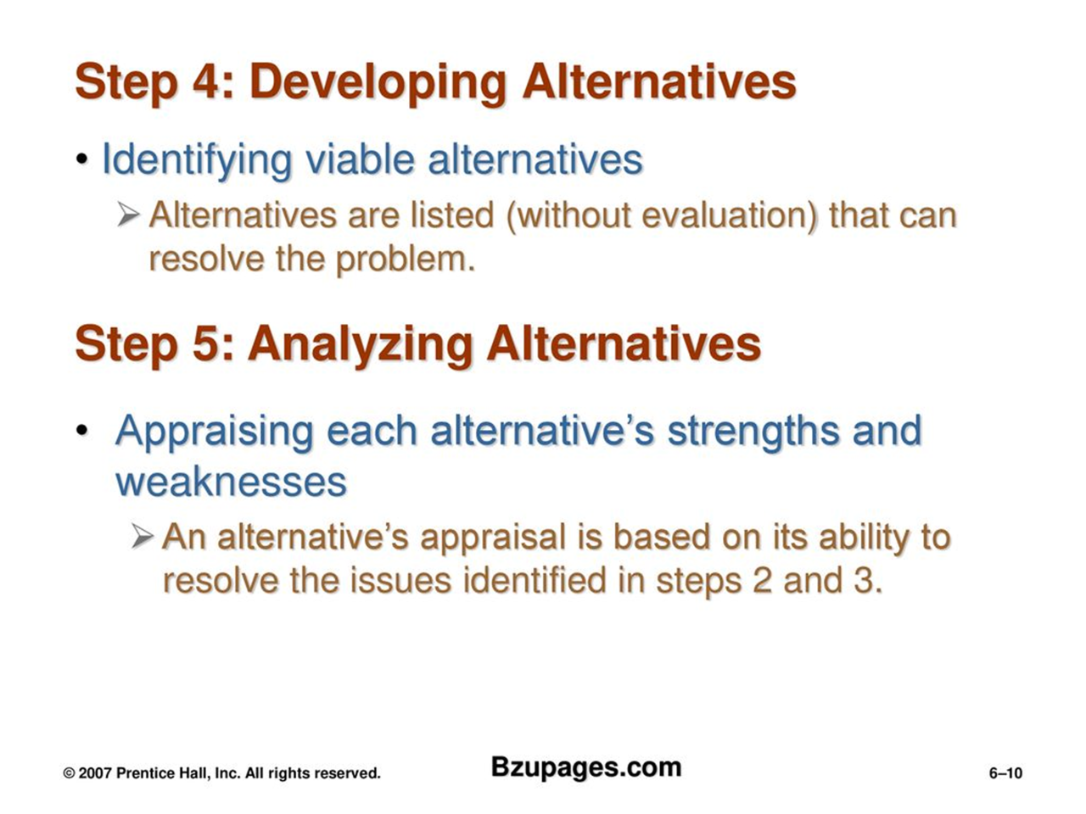

Slide 8
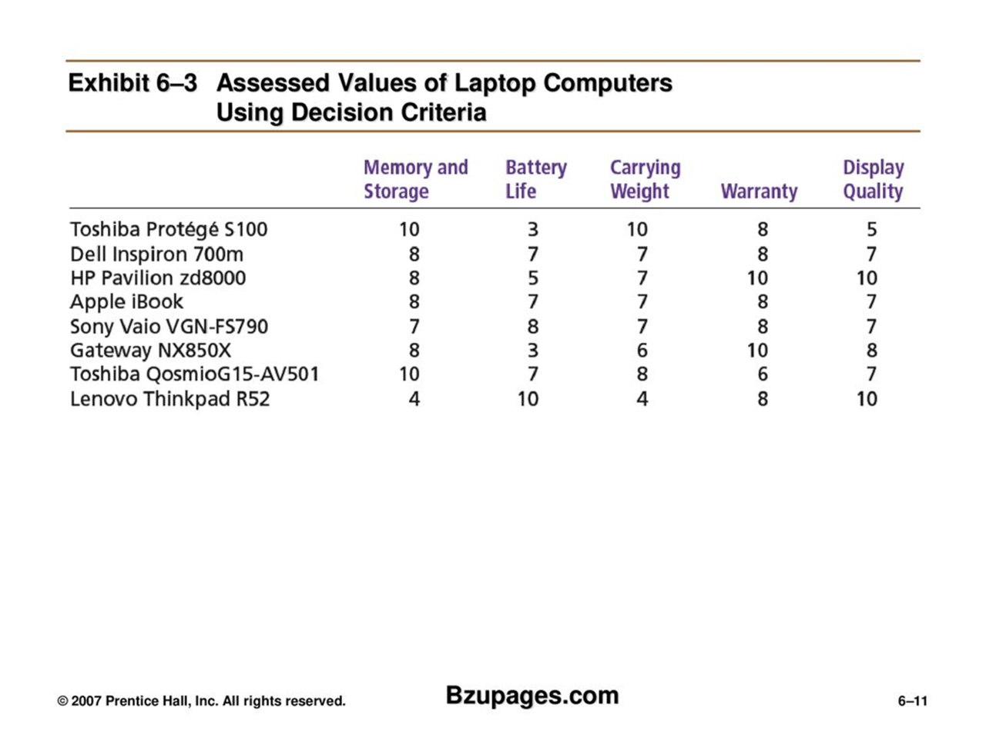

Slide 9
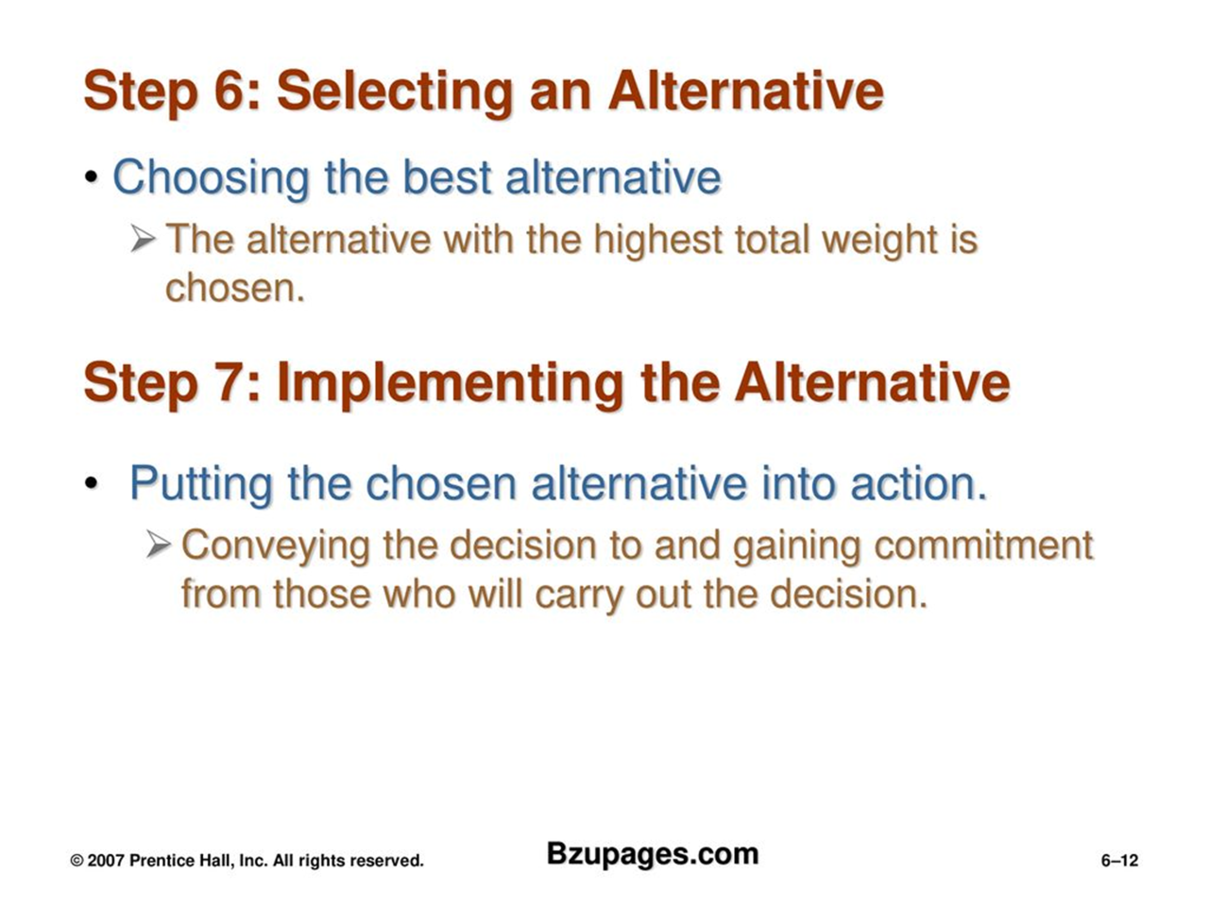

Slide 10
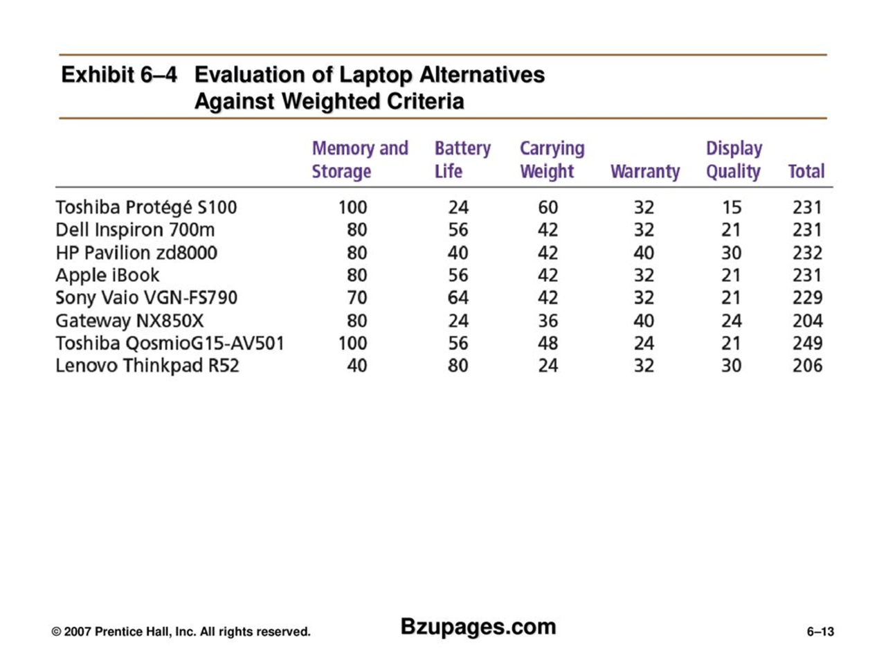

Slide 11
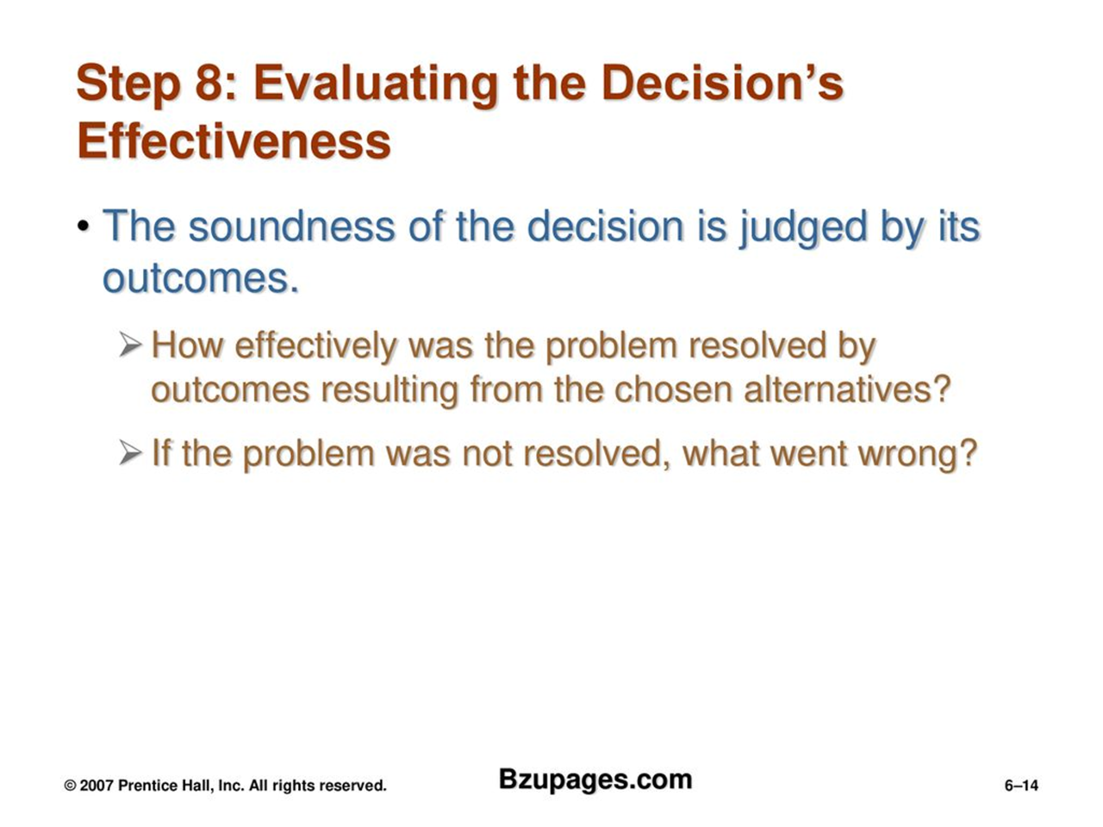

Slide 12
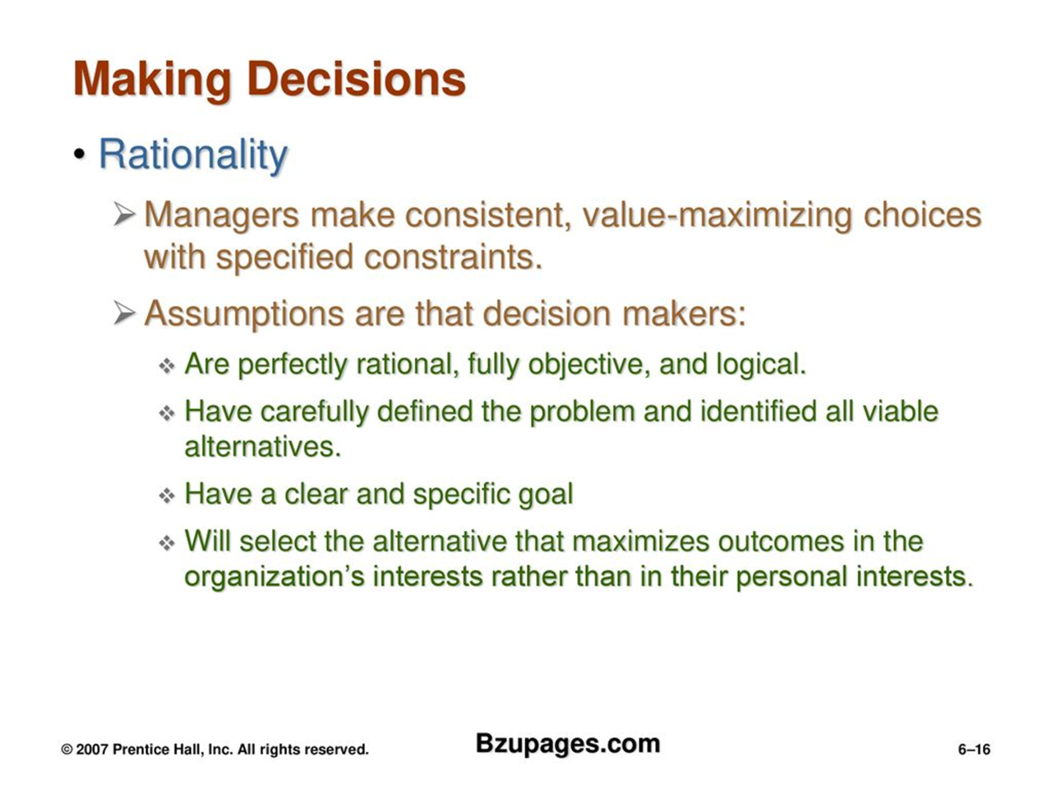

Slide 13
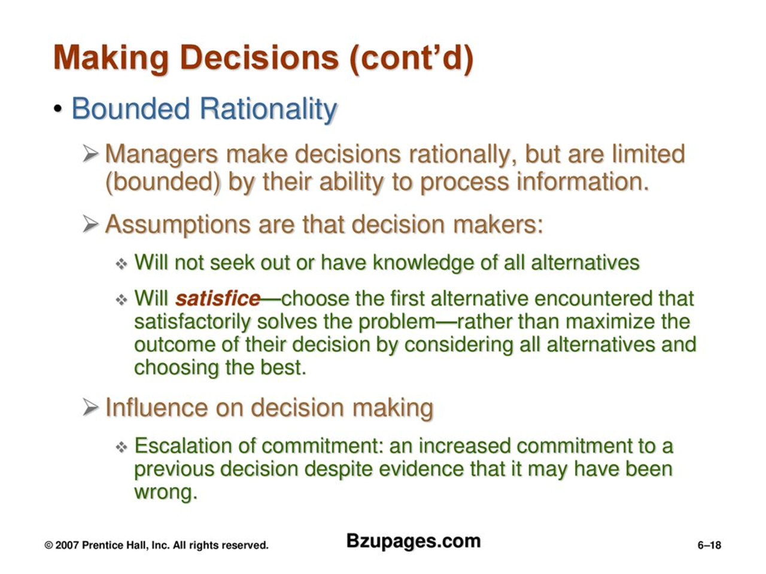

Slide 14
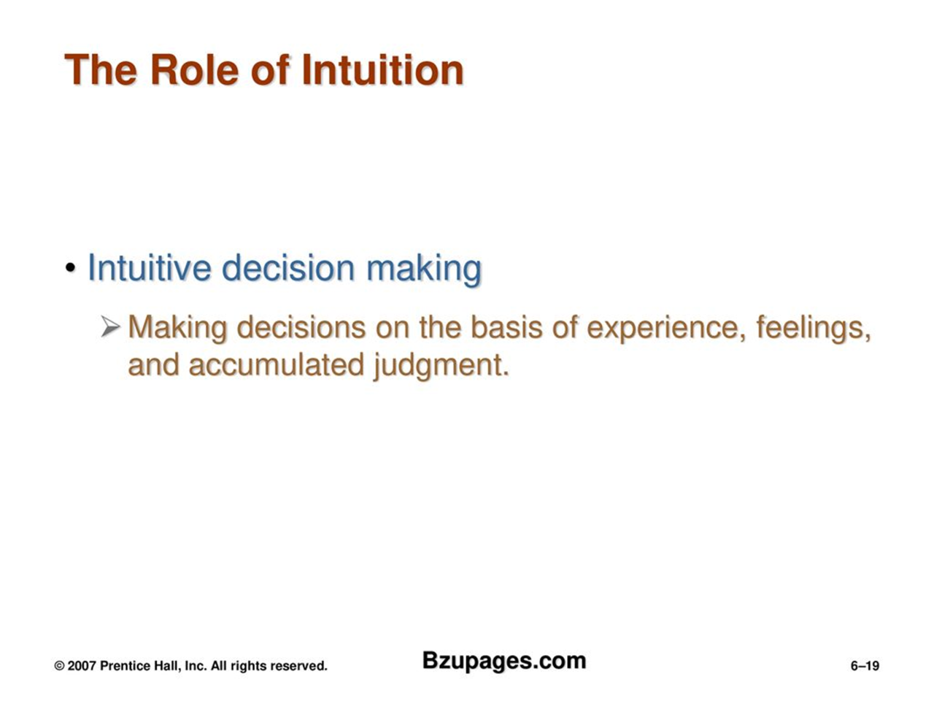

Slide 15
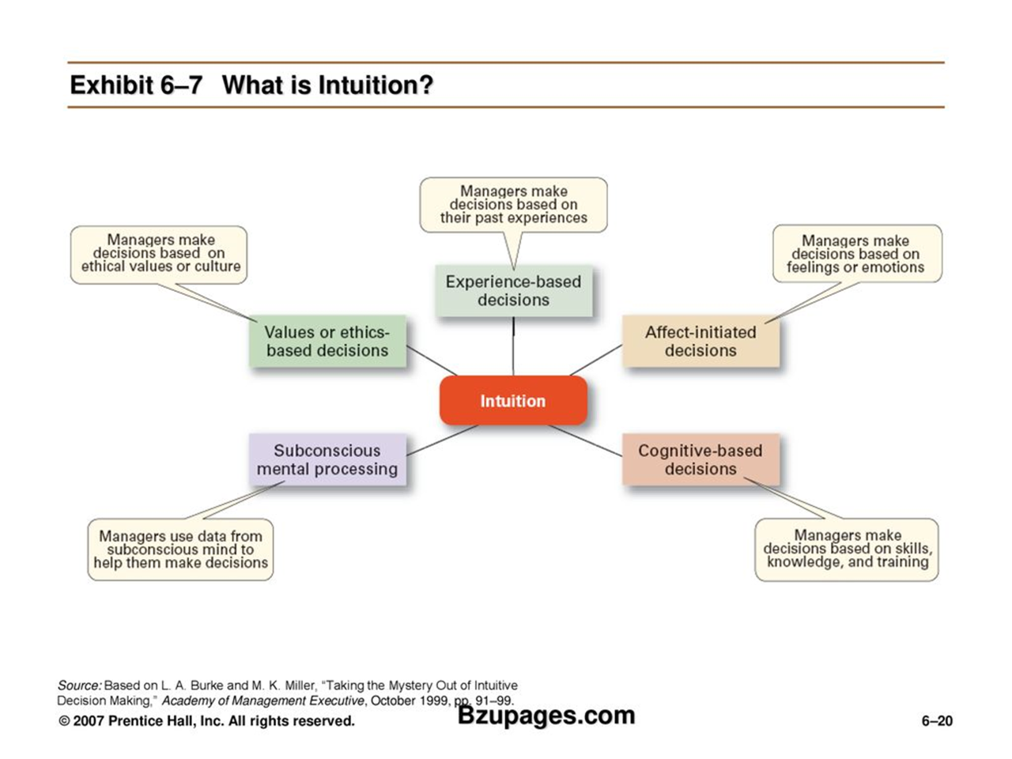

Slide 16
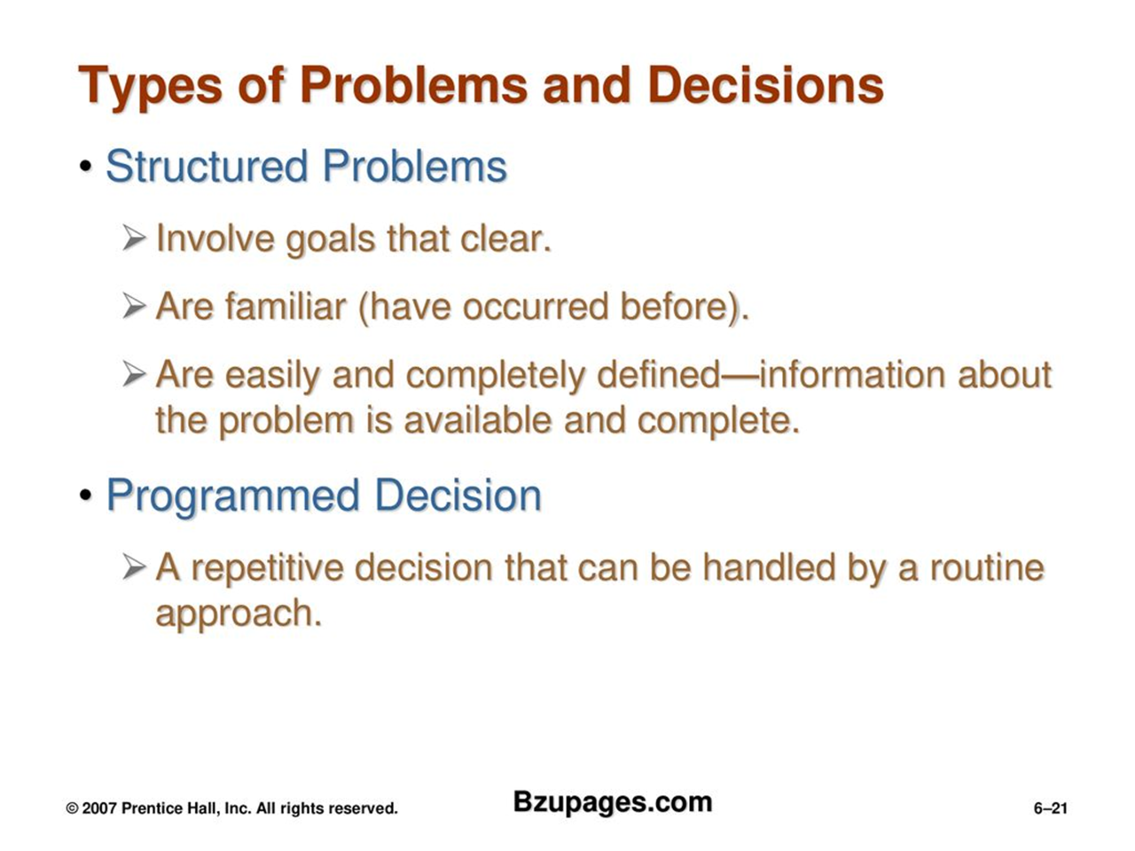

Slide 17
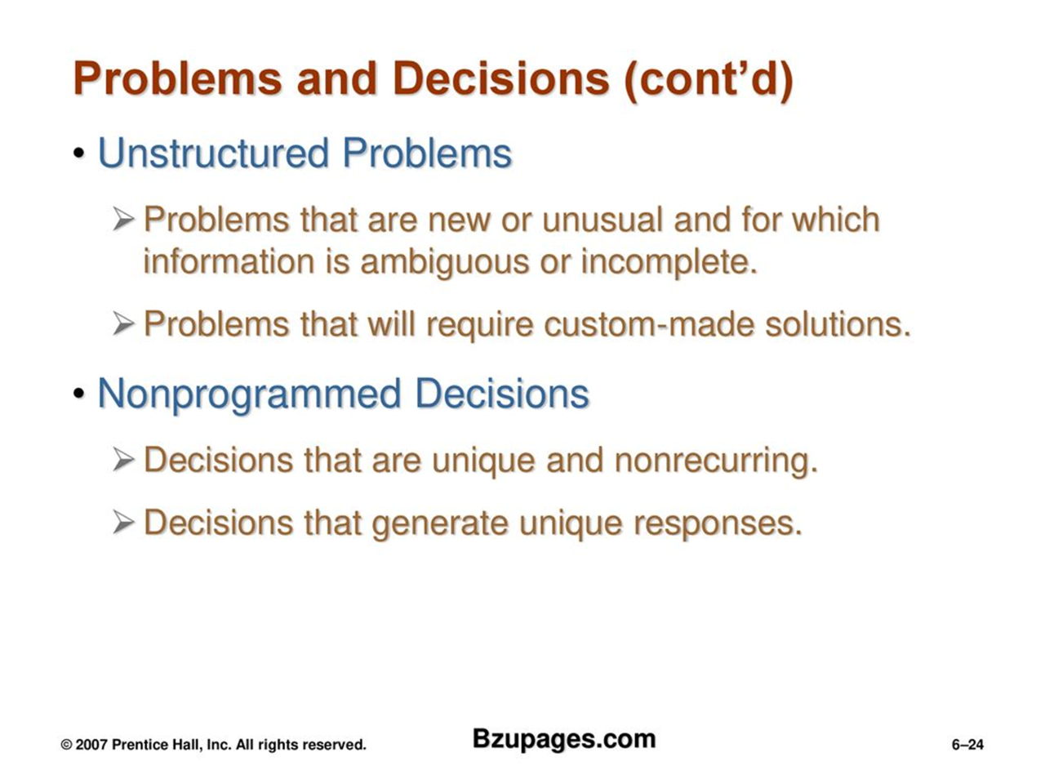

Slide 18
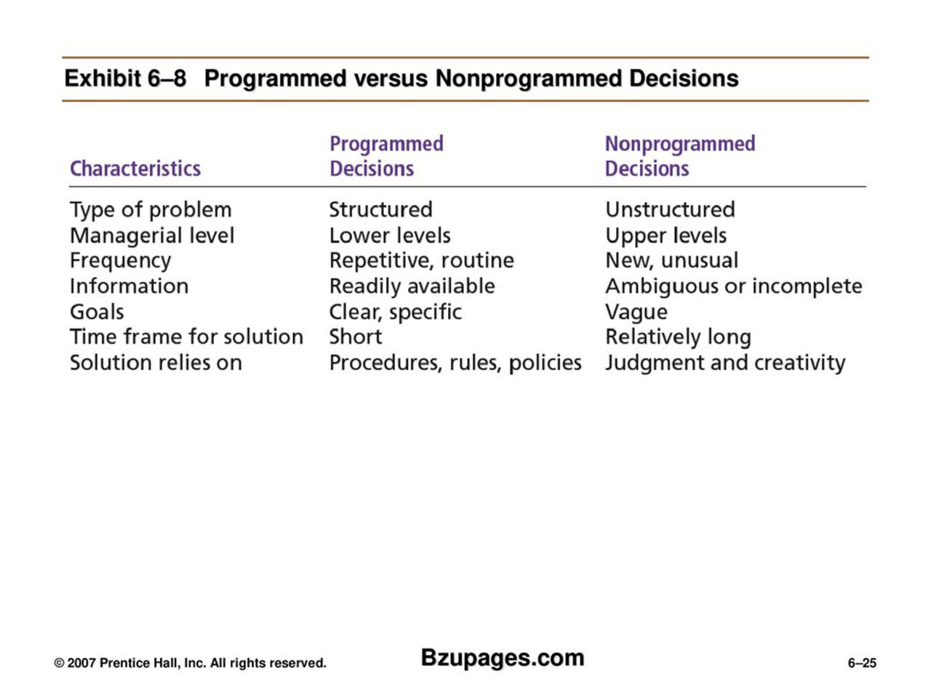

Slide 19
Decision Making Conditions/Alternatives
Certainty:
In decision making under certainty, all information is known, and the outcomes associated with each decision alternative are also known with complete certainty.
This is the simplest decision-making scenario because there is no ambiguity or doubt about the outcomes.
Decisions made under certainty typically involve straightforward calculations or application of predefined rules or criteria.

Slide 20
Decision Making Conditions/Alternatives
Example: Routine Manufacturing Process
In a manufacturing plant, there is a well-established and optimized process for producing a specific product.
The raw materials, equipment, labor requirements, and production schedule are all known and standardized.
Managers can confidently make decisions related to production scheduling, resource allocation, and inventory management because there is no uncertainty about the process or its outcomes.

Slide 21
Decision Making Conditions/Alternatives
Risk:
Decision making under risk involves situations where the decision maker has incomplete information but can assign probabilities to various outcomes.
While the probabilities are known, the exact outcome is uncertain.
In this scenario, decision makers can use tools such as expected value, expected utility, decision trees, or risk analysis techniques to evaluate alternatives and choose the option with the highest expected payoff or utility.

Slide 22
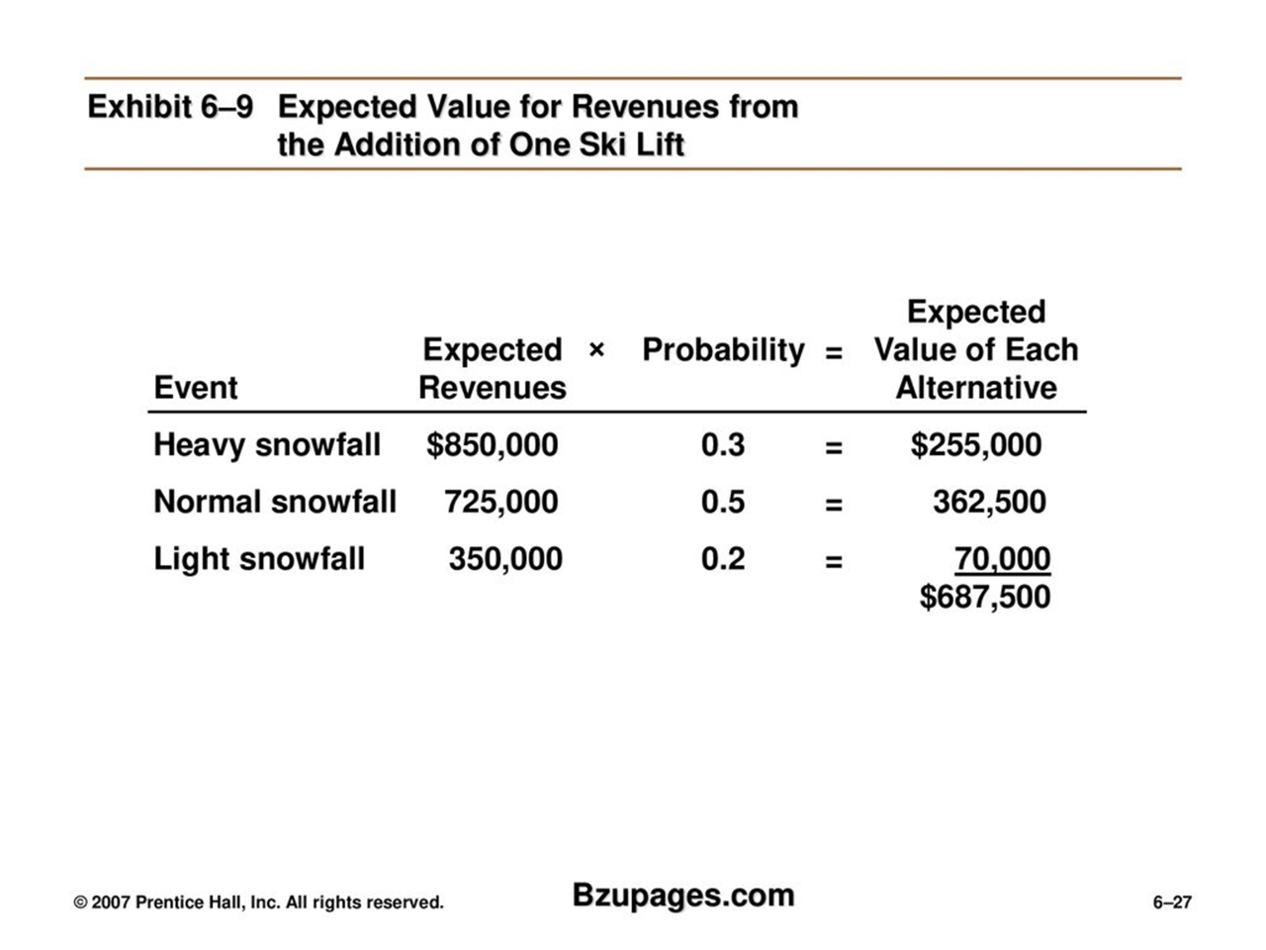

Slide 23
Decision Making Conditions/Alternatives
Uncertainty:
Decision making under uncertainty occurs when the decision maker lacks information about the likelihood of various outcomes or cannot accurately assess the probabilities associated with different alternatives.
Unlike in decision making under risk, probabilities cannot be assigned to potential outcomes.
Decision makers often rely on intuition, judgment, heuristics, or scenario planning to navigate uncertainty.
Strategies may involve maximizing flexibility, gathering more information, or using conservative approaches to hedge against potential negative outcomes.

Slide 24
Decision Making Conditions/Alternatives
Example: Tech Startup Market Entry Decision
Intuition:
The CEO of the startup, drawing upon their industry experience and entrepreneurial instincts, has a strong intuition that expanding into the new market is a promising opportunity.
Despite the lack of concrete data or market research, the CEO's intuition suggests that there is untapped potential for their product in this market.
Their intuition may be influenced by factors such as anecdotal evidence, industry trends, and a belief in the scalability of their technology.

Slide 25
Decision Making Conditions/Alternatives
Scenario Planning:
Recognizing the uncertainty inherent in the decision, the startup conducts scenario planning to explore various possible outcomes and develop contingency plans:
Best-case Scenario: They envision a scenario where market demand exceeds expectations, regulatory barriers are minimal, and they quickly establish a dominant position in the new market. In this case, they would allocate resources towards aggressive expansion and marketing efforts.
Worst-case Scenario: They consider a scenario where market adoption is slow, regulatory hurdles are significant, and competition intensifies. In this case, they would have contingency plans in place, such as scaling back operations, reassessing their market entry strategy, or pivoting to alternative markets.
Most Likely Scenario: They outline a scenario based on their best estimate of market conditions, demand projections, and competitive dynamics. This scenario serves as the basis for their strategic planning and resource allocation decisions.

Slide 26
Decision making styles
Decision-making styles vary among individuals and can depend on factors such as personality, experience, organizational culture, and the nature of the decision at hand. Four major decision-making styles commonly observed in individuals are:
Directive Style:
In the directive style, the decision-maker tends to be autocratic and assertive, taking charge of the decision-making process.
They rely on their own knowledge, expertise, and preferences to make decisions quickly and efficiently.
This style is often seen in situations where there is a sense of urgency, a need for clear direction, or when the decision-maker has a high level of expertise in the subject matter.
While this style can lead to rapid decisions, it may also overlook input from others and hinder collaboration.

Slide 27
Decision making styles
2. Analytical Style:
The analytical style involves a systematic and thorough approach to decision making, emphasizing data analysis, logic, and rationality.
Decision-makers in this style carefully gather and evaluate information, weigh the pros and cons of each option, and strive to make objective decisions based on evidence.
They may use decision-making tools such as decision matrices, cost-benefit analysis, or SWOT analysis to support their deliberations.
This style is beneficial for complex decisions where multiple factors need to be considered, but it may also lead to analysis paralysis or a tendency to overlook intuitive insights.

Slide 28
Decision making styles
3. Conceptual Style:
Individuals with a conceptual decision-making style are visionary, creative, and innovative.
They focus on big-picture thinking, exploring new ideas, and envisioning possibilities for the future.
Decision-makers in this style are comfortable with ambiguity and uncertainty, often drawing on intuition and imagination to generate novel solutions.
While this style can lead to breakthrough innovations and out-of-the-box solutions, it may also overlook practical constraints or implementation challenges.

Slide 29
Decision making styles
4. Behavioral Style:
The behavioral style emphasizes collaboration, empathy, and consensus-building in the decision-making process.
Decision-makers in this style prioritize relationships and consider the emotional impact of their decisions on others.
They seek input from stakeholders, listen to diverse perspectives, and aim to reach decisions that satisfy the needs and preferences of all parties involved.
This style is effective for fostering teamwork, building trust, and promoting buy-in from stakeholders, but it may also lead to indecision or conflict avoidance in situations where tough choices need to be made.

Slide 30
Group Decision Making
Group decision-making is the process of making decisions collectively by a group of individuals rather than by one person alone.
This approach is commonly employed in various settings, including businesses, organizations, committees, and teams.
Group decision-making offers the advantage of pooling diverse perspectives, knowledge, and expertise, which can lead to better-informed decisions and increased buy-in from participants.
However, it can also be more time-consuming and challenging to manage compared to individual decision-making.

Slide 31
Here are some techniques commonly used in group decision-making:
Brainstorming: In brainstorming sessions, group members generate ideas and solutions to a problem or question without criticism or evaluation. The focus is on quantity rather than quality initially, allowing for a wide range of ideas to be explored. Later, the group can evaluate and refine these ideas.
Nominal Group Technique (NGT): NGT is a structured approach to group decision-making that involves individuals generating ideas independently and then sharing them with the group. After all ideas are shared, they are discussed and evaluated collectively, typically using a voting or ranking system to prioritize options.

Slide 32
4. Multi-Voting: Multi-voting is a technique used to prioritize a list of options or ideas generated by a group. Each participant is given a certain number of votes, which they can distribute among the options based on their preferences. This helps to identify the most preferred options and can streamline decision-making.
5. Consensus Decision-Making: Consensus decision-making aims to reach a decision that all group members can support, even if it's not their first choice. It involves open discussion, active listening, and a willingness to compromise to find a solution that satisfies everyone. Unlike other decision-making methods where decisions are made by majority vote or by the authority of a single leader, consensus decision-making aims to reach an outcome that reflects the collective preferences and concerns of all participants. This approach is often used in settings where cooperation, collaboration, and group cohesion are valued, such as community organizations, non-profits, and some business teams.

Slide 33
5. Delphi Technique: The Delphi Technique is a structured method for forecasting or decision-making that involves multiple rounds of anonymous feedback from experts or stakeholders. In each round, participants review the feedback from previous rounds and provide their revised opinions, gradually converging towards a consensus.
6. SWOT Analysis: SWOT (Strengths, Weaknesses, Opportunities, Threats) analysis is a strategic planning tool used to evaluate the internal and external factors that may affect a decision. Group members identify and analyze these factors collectively to assess the potential impacts on the decision at hand.

Slide 34
7. Role-playing and Simulation: In some cases, group decision-making may involve role-playing or simulation exercises to explore different scenarios and their implications. This can help groups better understand the consequences of their decisions and identify potential challenges or opportunities.

